Slide 1
IDM EMOD-TB model walk-through

Slide 2
Outline
EMOD-TB model walk-through
Natural history
Transmission
Diagnosis
Treatment
Data
How data are used in EMOD-TB
Wish list of data for EMOD-TB

Slide 3
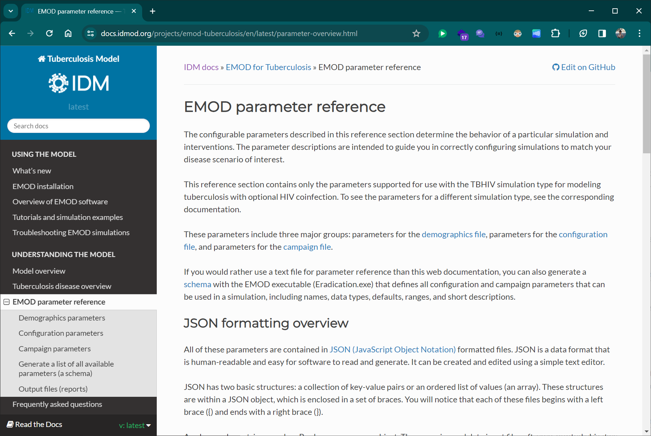
EMOD-TB Model documentation
Detailed descriptions of model parameters
https://docs.idmod.org/projects/emod-tuberculosis/en/latest/parameter-overview.html

Slide 4

SA model publication
Includes model, parameter description in Supplement

Slide 5
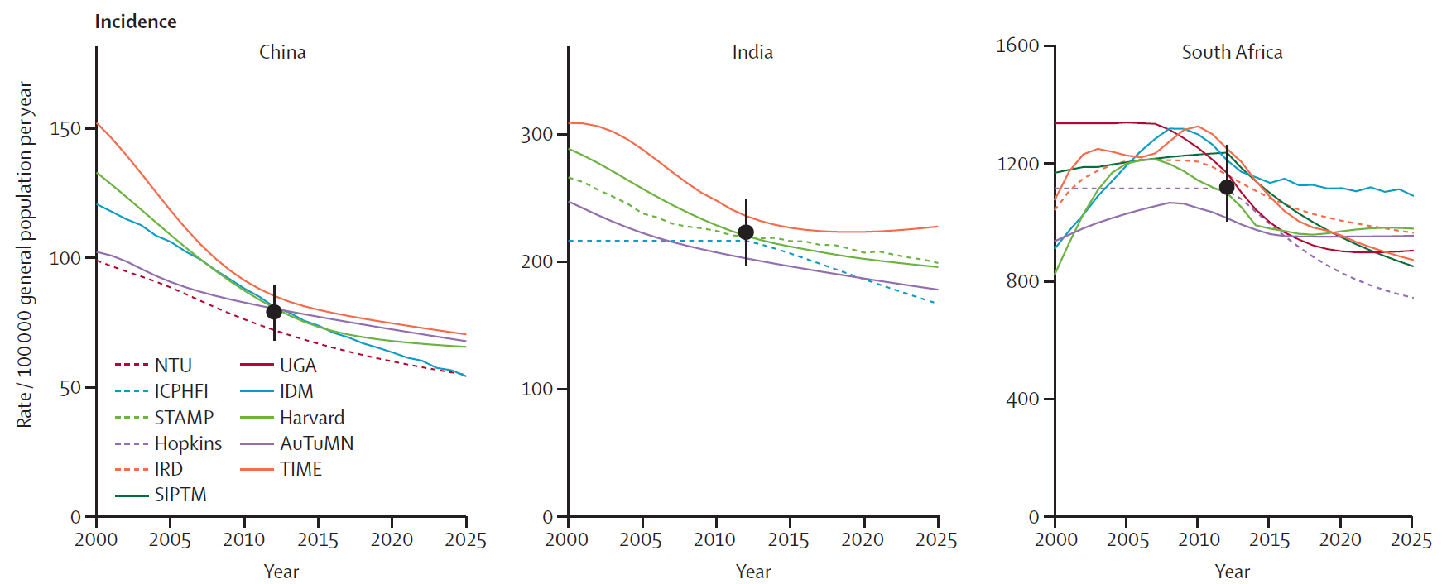
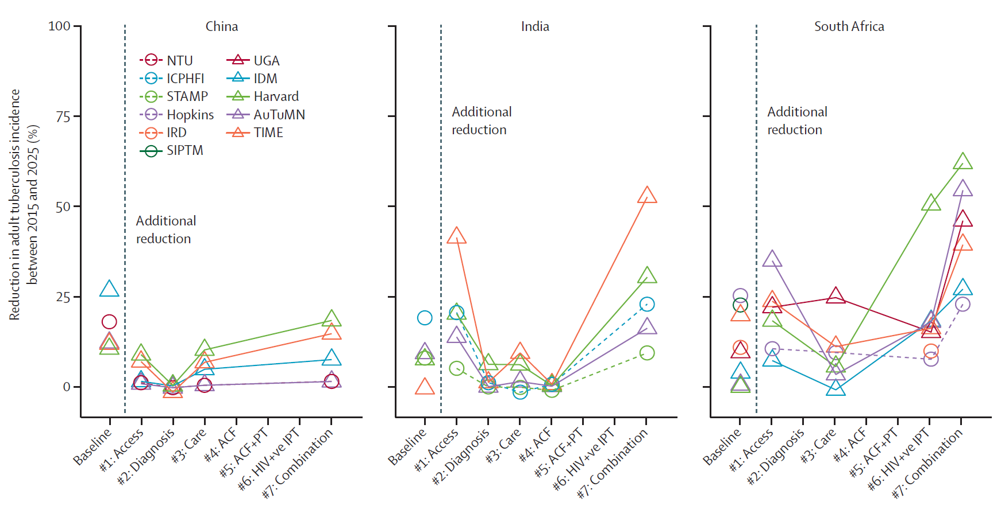
TB-MAC publication including IDM results
Incidence by year and country
Incidence rate reduction by intervention type
Houben 2016 https://www.thelancet.com/journals/langlo/article/PIIS2214-109X(16)30199-1/fulltext

Slide 6
TB natural history in EMOD-TB Model
Uninfected
Infection*
Latent
Cure = 0
Pre-Symptomatic
Cure = 0
Active
Cure = 2.4e-4
Fast Progressor
Fraction = 0.1
Slow Progressor
Fraction = 0.9
Latent
Latent Fast
Latent Slow
Inactivation = 0
Model is agent-based and therefore stochastic
Compartments used for representation purposes
TB Fast
Progression = 6e-3
TB Slow
Progression = 3e-5
Active Pre-Symptomatic
Pre-Symptomatic
Rate = 3e-2
Smear-Positive
Fraction = 0.65
Smear-Negative
Fraction = 0.25
Extra-Pulmonary
Fraction = 0.1
In general, rates can be interpreted as mean time to transition
For example, for TB Fast Progression, 1 / (6e-3) = 167 days
Active
Smear-Positive
Smear-Negative
Extra-Pulmonary
Active
Mortality = 4.5e-4
Smear-Negative
Mortality = 0.3 x
Active Mortality
Extra-Pulmonary
Mortality = 0.15 x
Active Mortality
TB Mortality
EMOD-TB model structure based on Abu-Raddad et al. (2009), https://doi.org/10.1073/pnas.0901720106

Slide 7
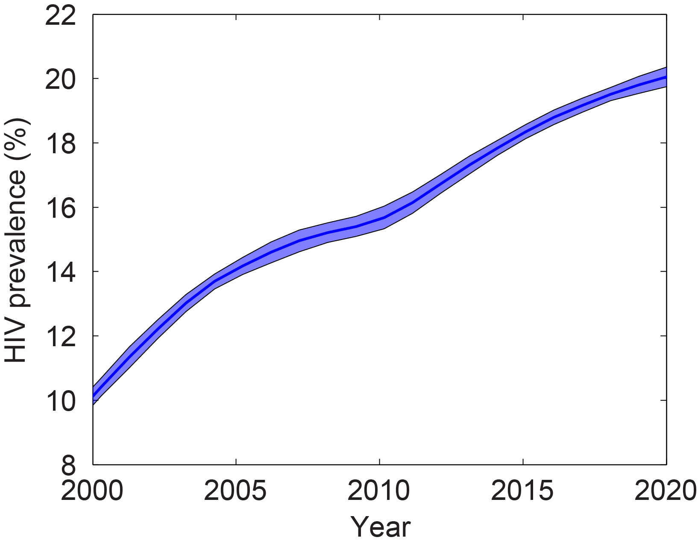
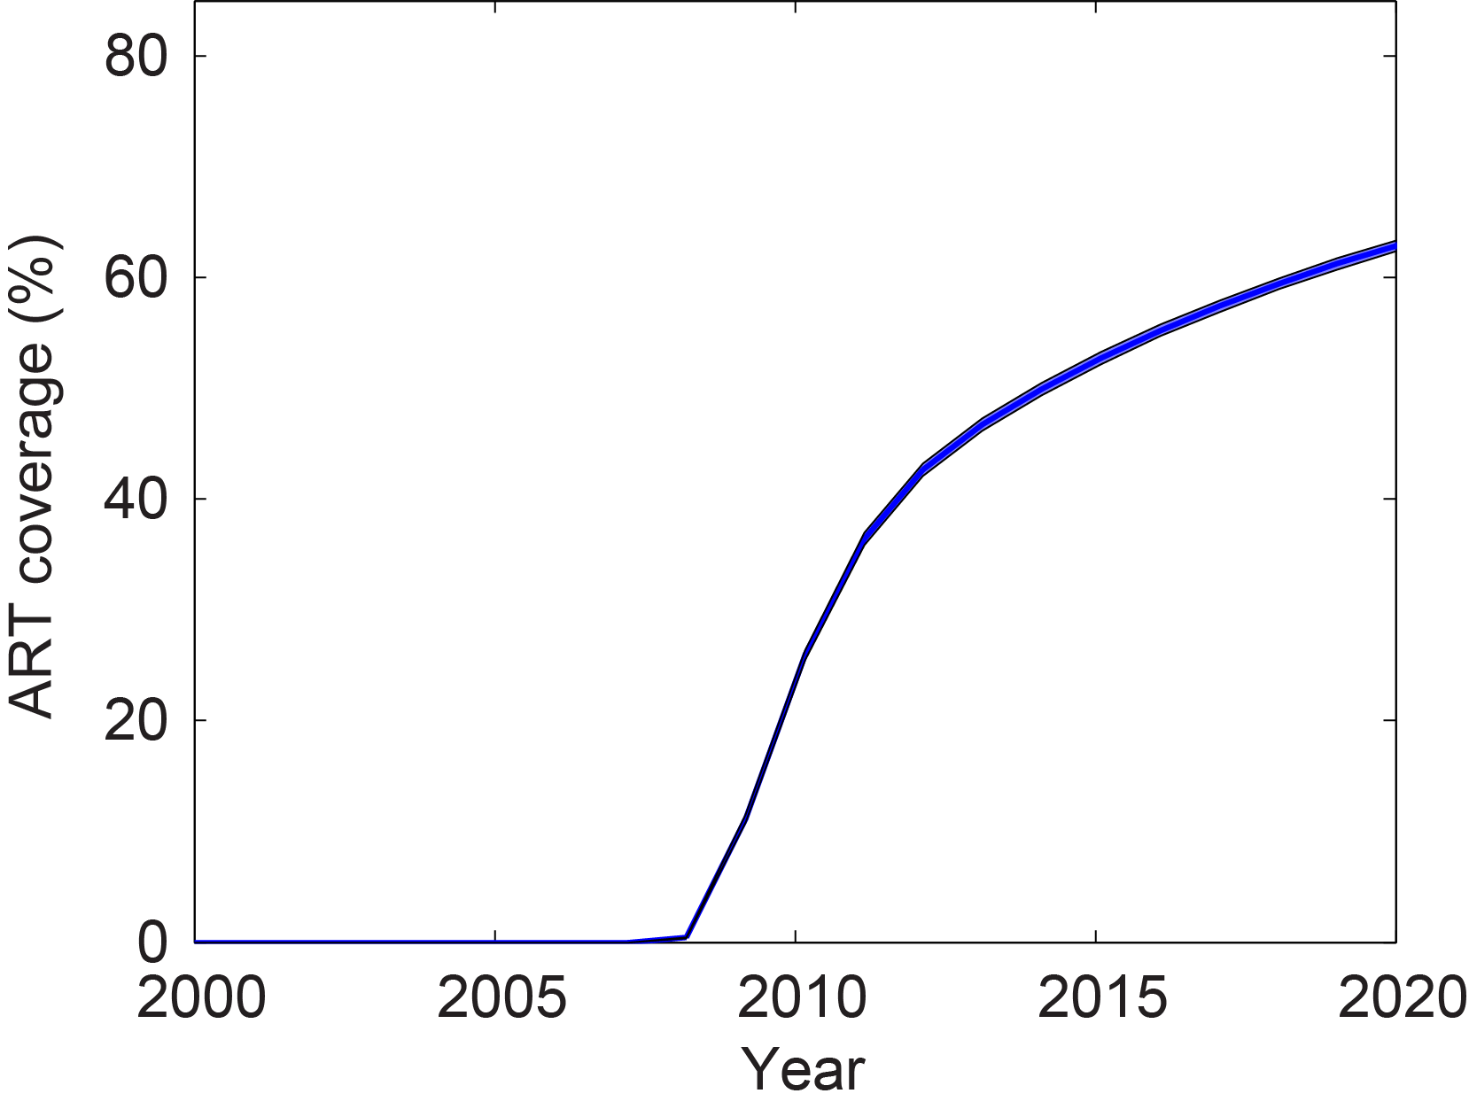
HIV from EMOD-HIV Model
Model takes input for:
HIV infections per year
HIV testing, ART initiation rates
Model outputs:
Population HIV prevalence
Individual CD4 decline, reconstitution on ART
TB parameters affected by HIV infection (with defaults):
Susceptibility (= 1, same as HIV-negative)
Infectiousness (= 0.5, i.e., half as infectious as HIV-negatives)
Activation (varies, 10⁻⁴ at low CD4 and 10⁻⁵ at high CD4)
Drug efficacy (= 1)

Slide 8
Transmission in EMOD-TB Model
Uninfected
Susceptibility:
Infection (see right)
Latent
Latent Fast
(Ever) Infected = 50% protection
Latent Slow
Fully susceptible
Active Pre-Symptomatic
Infectiousness
Pre-Symptomatic Infectivity =
Varied (0 - 0.2 x Base Infectivity)
Active Pre-Symptomatic
Active
Smear-Positive
Base Infectivity = Calibrated
(R0 / time = 8 - 20 infections / yr)
Smear-Negative
Smear-Positive
Extra-Pulmonary
Smear-Negative Infectivity =
0.2 x Base Infectivity
Smear-Negative
Extra-Pulmonary
Extra-Pulmonary Infectivity = 0
TB Mortality

Slide 9
Diagnostics in EMOD-TB Model
Health-Seeking Triggers:
TB Activation
TB Drug Failure
TB Test Default
TB Test Negative
Active
Smear-Positive
Smear-Negative
Extra-Pulmonary
Health-Seeking
Low Quality = 30%
Seeking = 1 / 210 d
High Quality = 70%
Seeking = 1 / 90 d
GeneXpert +
empiric
Sens (S+) 70%
Sens (S-) 70%
GeneXpert +
empiric
Sens (S+) 99%
Sens (S-) 90%
Other available tests
Smear microscopy
Test negative
Test positive
Untreated = 20%
Treated = 80%
Treatment
outcomes

Slide 10
Treatment in EMOD-TB Model
Uninfected
(On-)Drug
Cure = 1.3e-2 ~ 79%
Latent Slow
(On-)Drug Inactivation
= 1.7e-3 ~ 10%
Pending Relapse
Drug Efficacy Multipliers:
Relapsed to
Active = 1e-2
(< 1 year)
(On-)Drug Relapse
= 3.3e-4 ~ 2%
(Ever) Failed = 100%
(Ever) Relapsed = 100%
HIV = 100%
Active
MDR = 1-5%
Smear-Positive
Smear-Negative
(Drug
Failure) ~ 6%
(Drug
Failure)
Extra-Pulmonary
MDR evolution during treatment:
(Drug
Failure)
DS
(On-)Drug Mortality
= 5e-4 ~ 3%
Failed, Relapsed, or Inactivated
TB Mortality
(On-)Drug Resistance = 1e-4
MDR

Slide 11
Data used in creating EMOD-TB for SA
Input data (used as parameters):
HIV incidence, prevalence
HIV testing, ART scale-up
Diagnostics (sensitivity of empiric, smear microscopy, GeneXpert)
Calibration data (used to adjust free parameters with formal likelihoods):
TB incidence, mortality estimates (from WHO, IHME estimates)
TB incidence by HIV status
Other data (used to check model outputs):
Care cascade (e.g., survey from Naidoo et al. 2017)
MDR prevalence rates
Relapse rates

